Slide 1
Light-e-pen
-Write in the dark
Presented By
“CRAZY 4”
Aanchal Garg
Shubham Singh
Rishin Halid
Jharesh Akella

Slide 2
Top three Ideas
The Adjustable Comb ( Many in one )
The Item Tracker
The LED Pen

Slide 3
Problem Statement
Everybody needs a source to write in dark or low light conditions because the sources available are bulky, expensive and inefficient.

Slide 4
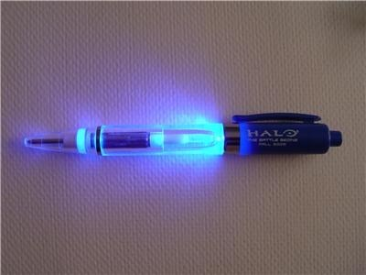
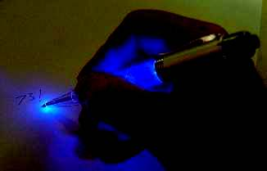
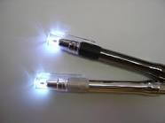
LED Pens available in market

Slide 5
Limitations of existing LED pens
Too dim to write
Expensive ($16.96)
Bulky
Complex

Slide 6
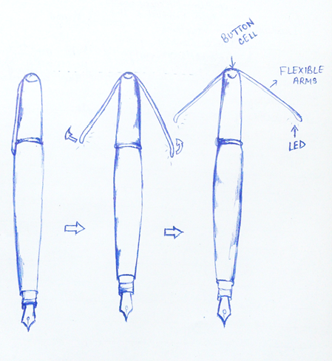
Our Solution

Slide 7
Advantages
Easy to write in dark
Cheap
Substitute for torch light
Robust and light-weight
The cap can be attached with all pen sizes due to the presence of rubber lining inside the cap

Slide 8
* Battery pack can be replaced.
*Low-cost.
*Simple switch operation.
*Cap can be used with other pens with the help of rubber lining inside the cap.
Battery life is low.
It is difficult when we write from other sources such as textbooks.
We can write comfortably in dark by using this LED pen.
Alternatively, using attractively designed caps, it can be used as a toy.
Existing products are inefficient.
They are expensive.
The pens are bulky and fragile.
Soldiers can use in war fields.
Children will enjoy writing with such pens.

Slide 9
Estimated production cost (per unit)
Body material - 2/- to 3/-
LEDs - 3/-
Button cells - 10/- to 15/-
Overall cost - 15/- to 21/-

